Slide 1
Name: Sayyed MAZAIN Enrolment No: EN12022075230 JUKEBOX PROJECT
Under the Guidance of- Shilpi Mam,
Shruti Mam

Slide 2
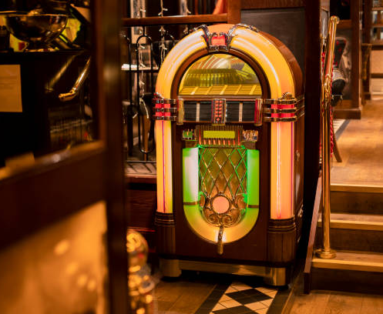
JUKEBOX ?
Jukebox is a music player.
Jukebox helps listeners to choose among songs to play music.
Designing the modern JukeBox Was our Task.

Slide 3
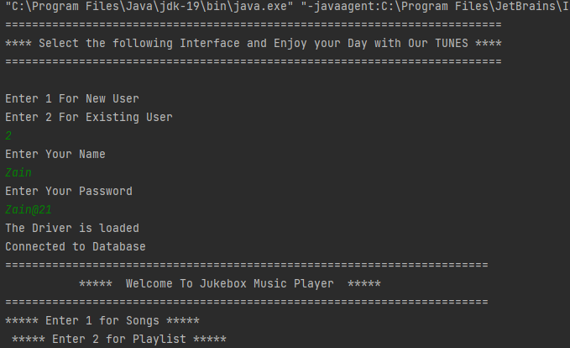
Features of the Jukebox Project:-
Log in to the portal.
Enter new or existing user .
Get welcome interface on console.
By using different key to excess the function.

Slide 4
1.OOPS 2.CONDITIONAL [WHILE LOOP, SWITCH CASE , IF-ELSE, LOOPS 3.COLLECTIONS [ARRAY LIST] 4.MYSQL 5.JDBC 6. EXCEPTION HANDLING
Features used to Impelement project

Slide 5
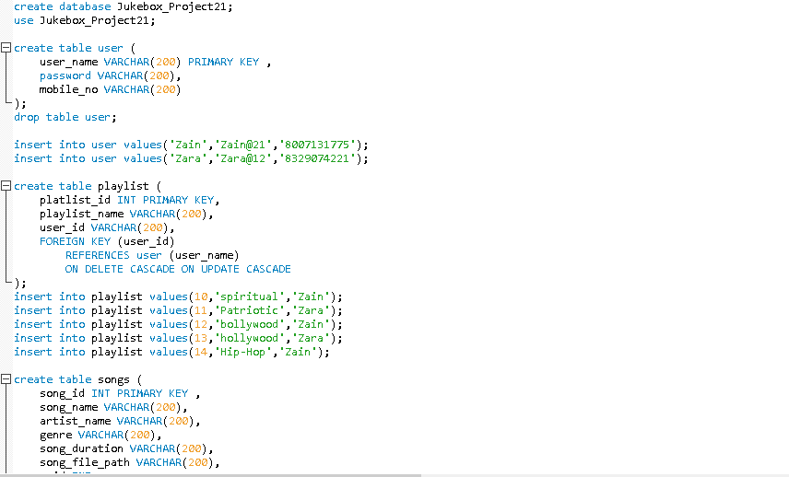
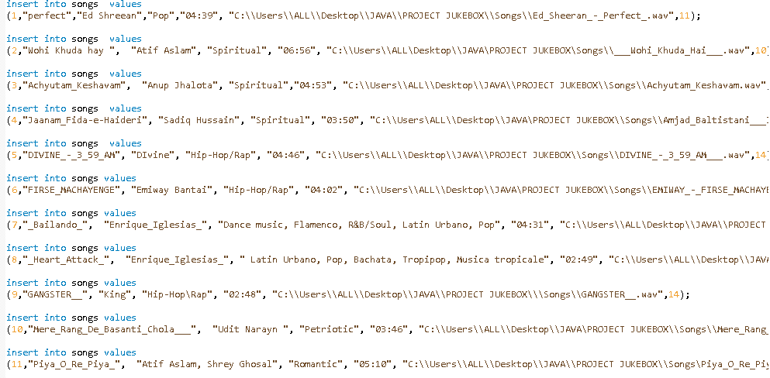
Database Creation
Tables For User, Playlist, Songs
Insertion of values into table

Slide 6
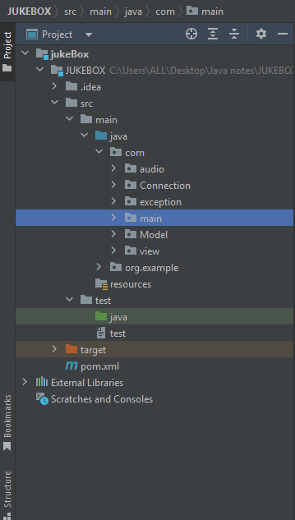
PACKAGES
To store basic data we have created a package.
A package in Java is used to group related classes.
It resembles like a folder in a file directory.
We use packages to avoid name conflicts, and to write a better maintainable code

Slide 7
CLASSES
SimpleAudioPlayer- >(audio play)
JukeBoxTestCase ->
(to verify that the application works the way we want)
MakeConnection ->(mySql)
SongPathNotFoundException -> (user exception)
Songs , User ->(Pojo)->Plain Old java Object
AudioConnection , Playlist, SearchSongs , UserDetails,
->(Implementation class )
Jukebox -> (Main method\ Calling method)

Slide 8
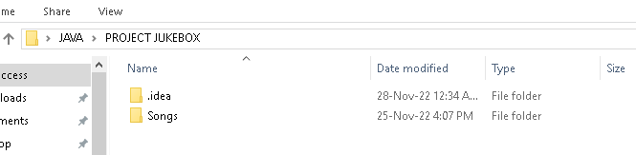
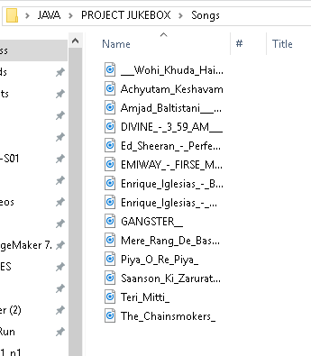
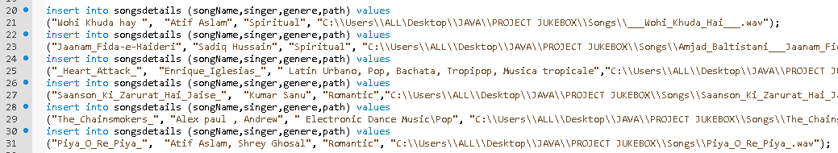
Storing the Songs:-
Area where the song is available
Songs in database

Slide 9
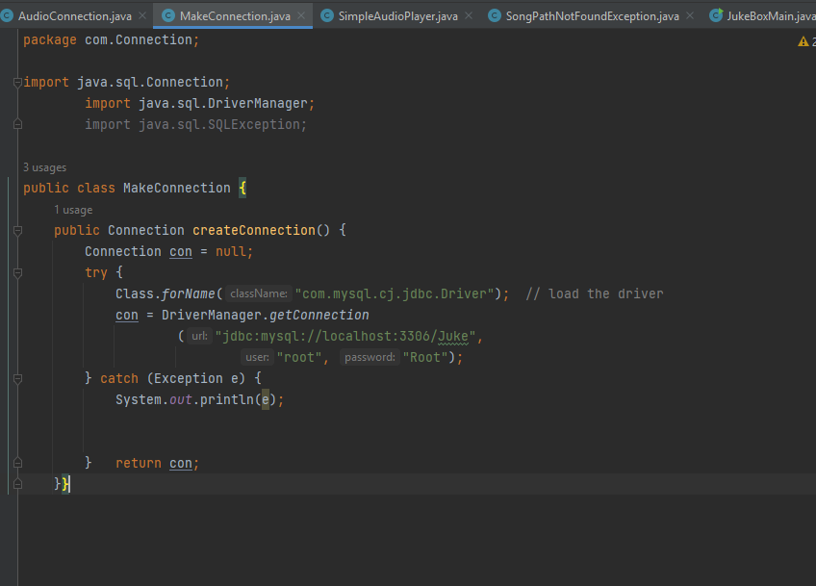
Creating Connection:-
The most Crucial part of our project is to connect java code with database .

Slide 10
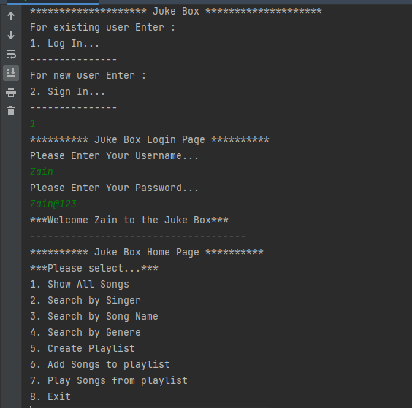
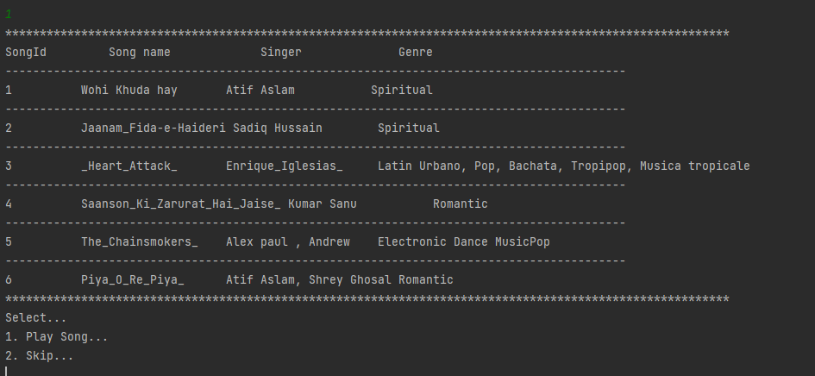
Output:-
Main Menu
Displaying Song

Slide 11
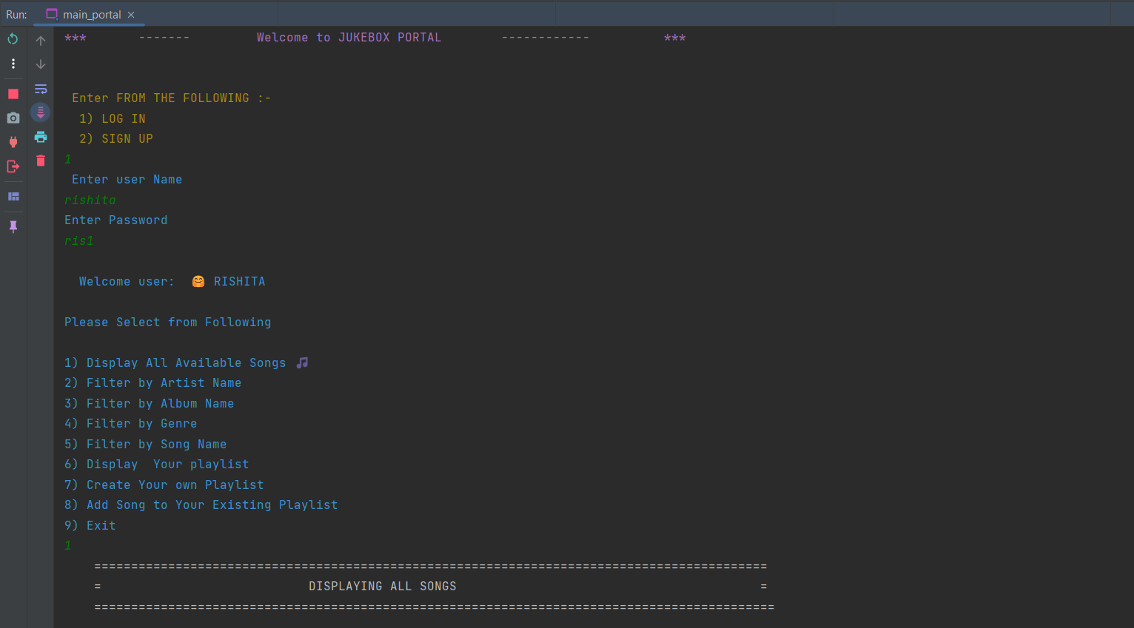
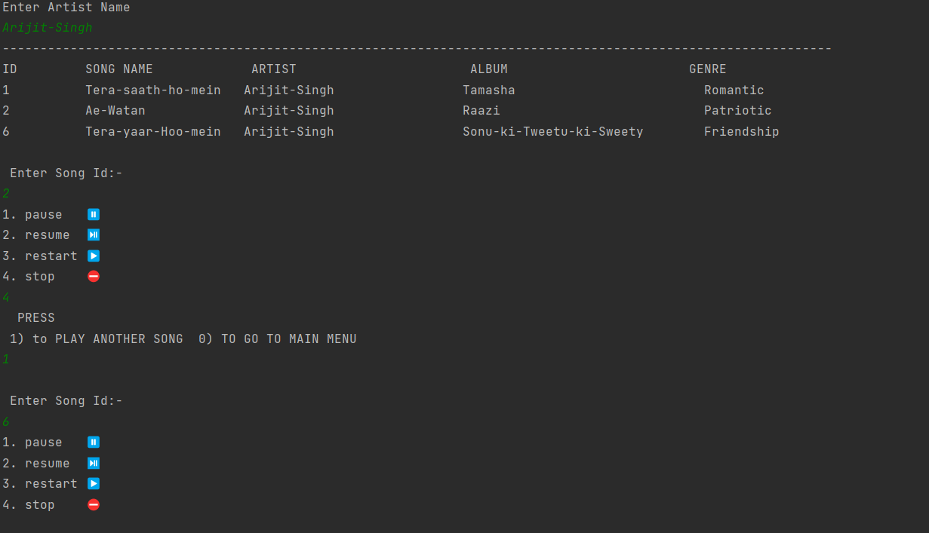
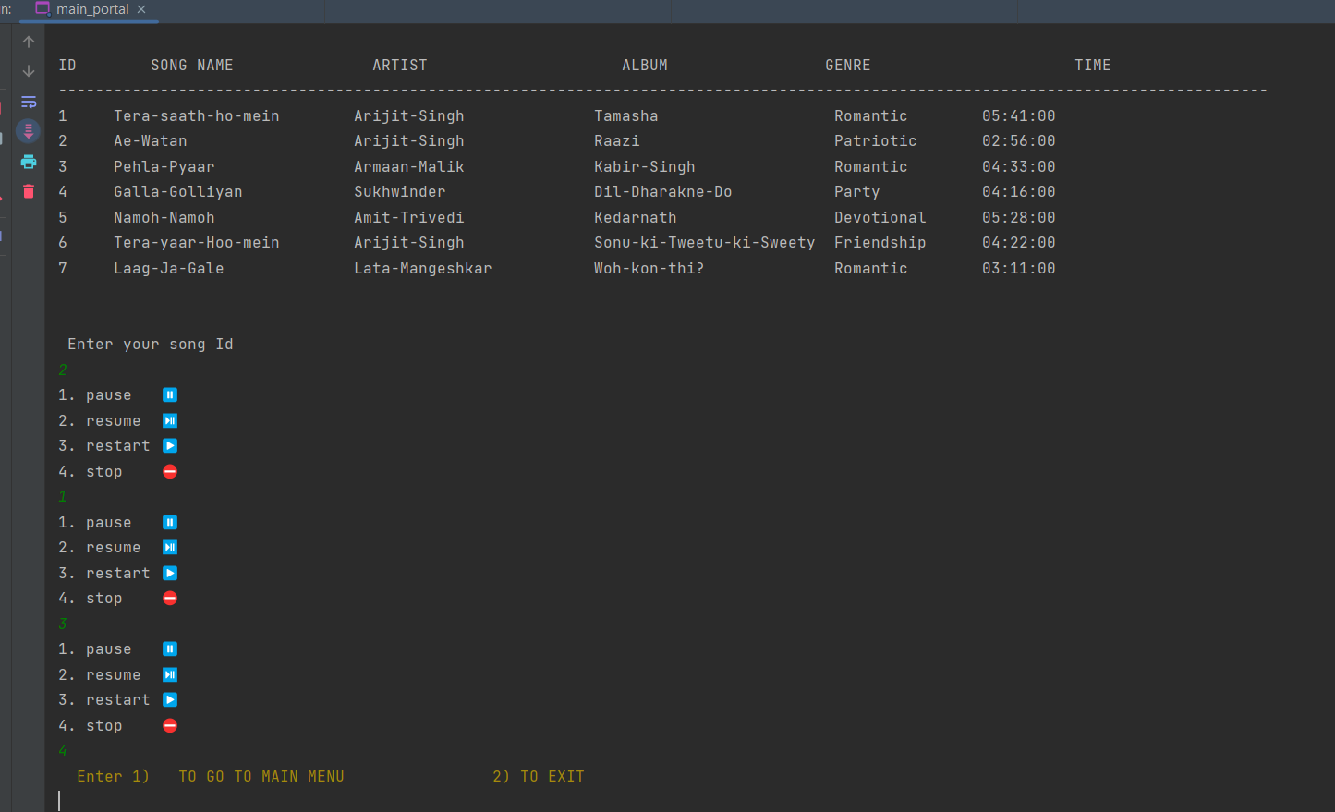
Output:-
Filter by Artist Name
Displaying Song

Slide 12
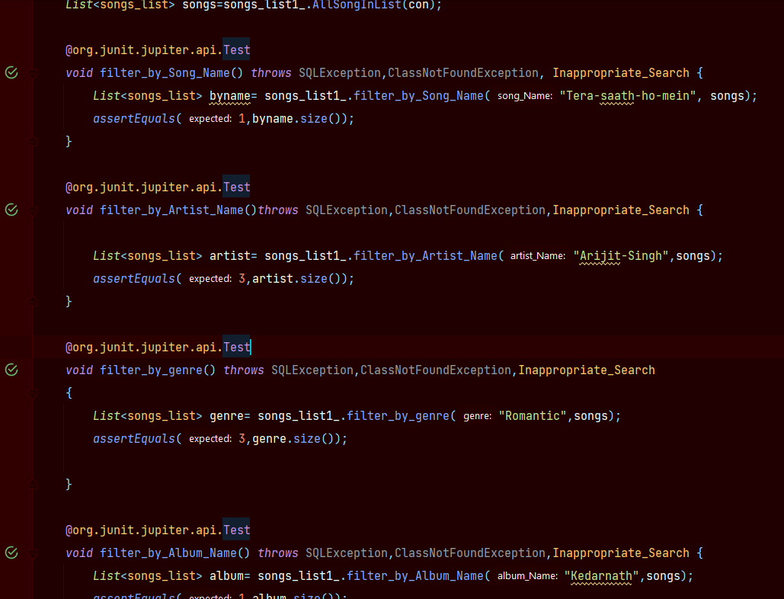
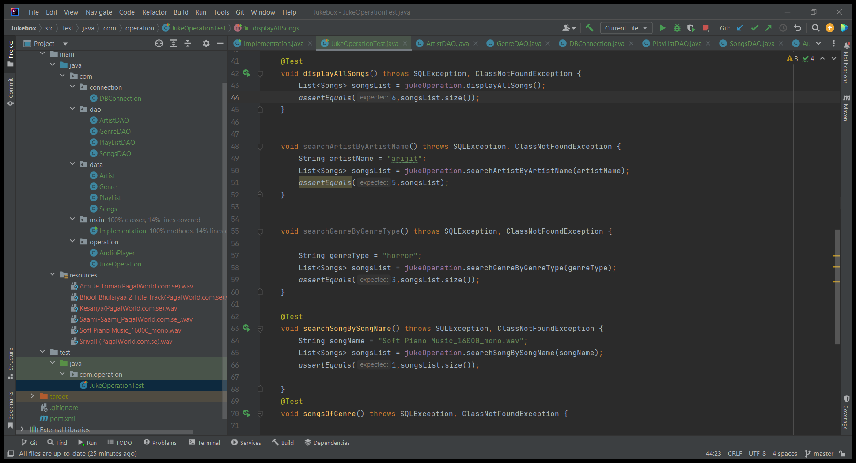
Test Case:-
Creating test cases are
important for the project so
that we can identify if the
project running properly or not
Here are the few test cases
we’ve created for the project.

Slide 13
THANK YOU

